Slide 1




EPIC GitHub Tutorial:
Contributing to UFS/EPIC Repositories
https://github.com/NOAA-EPIC/training-github
EARTH PREDICTION INNOVATION CENTER (EPIC)

Slide 2
Welcome!
Tutorial materials and a training session presentation could be found at https://github.com/NOAA-EPIC/training-github
The tutorial presents general directions for Mac OS or Linux* system (Terminal)
Complete all prerequisite steps as listed in a README.md : - git installed (via Homebrew for Mac OS, “git-bash” for Windows)
- basic command-line interface (CLI) commands
- opened a GitHub account
EARTH PREDICTION INNOVATION CENTER (EPIC)

Slide 3
Outline of the GitHub Tutorial
Part 1. Git/GitHub Basics
Cover some Git and GitHub terms and concepts
Basic Git commands to git you up
Set up a SSH key pair for easy GitHub authentication
Create your own repository
Track your local changes
Push your local changes to your GitHub
EARTH PREDICTION INNOVATION CENTER (EPIC)

Slide 4
Outline of the GitHub Tutorial
Part 2. Working with Remote Repositories
Checkout remote repositories: forks and clones
Creating and managing GitHub forks, branches
Submitting pull requests
Fetching and merging remote branches
Resolve merge conflicts
Keeping local repositories in sync with remote ones
EARTH PREDICTION INNOVATION CENTER (EPIC)

Slide 5
Part 1.
Basic Git Terms and Concepts
Git: A program; a free, open-source version control system
Version control system (VCS): software providing management of changes to computer programs, documentation, web sites, etc.
GitHub (github.com): The host website for many free and open-source repositories, including numerous ones by NOAA
Repository (repo): a set of code, documents, website(s), etc., that are version controlled
Branch: a working version of a repository with its own change history
EARTH PREDICTION INNOVATION CENTER (EPIC)

Slide 6
Basic Local Git Commands (git + <command>)
config: configure your git experience
init: create a new local repository in the existing directory tracked by git
add: add files to be tracked by git
commit: save changes you have made to the repository
branch: verify a current branch, copy the current branch to create a new one
checkout: check out a specific branch within a repository
log: show recorded (committed) change history to the repository
status: show changes to the repository since the recent commit
diff: show local file/line-by-line changes to the repository since the recent commit
EARTH PREDICTION INNOVATION CENTER (EPIC)

Slide 7
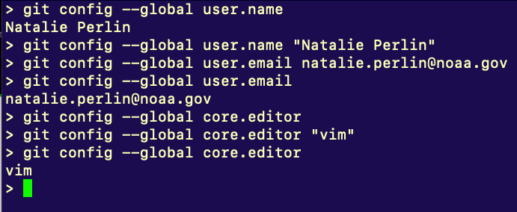

Common Local Git Commands
config: configure your git experience
init: create a new local repository in the existing directory tracked by git
add: add files to be tracked by git
commit: save changes made to the repo
branch: verify a current branch, copy the current branch to create a new one
checkout: check out a specific branch
log: show recorded (committed) change history
status: show changes to repository since the recent commit
diff: show local file/line-by-line changes to the repository since the recent commit
EARTH PREDICTION INNOVATION CENTER (EPIC)

Slide 8
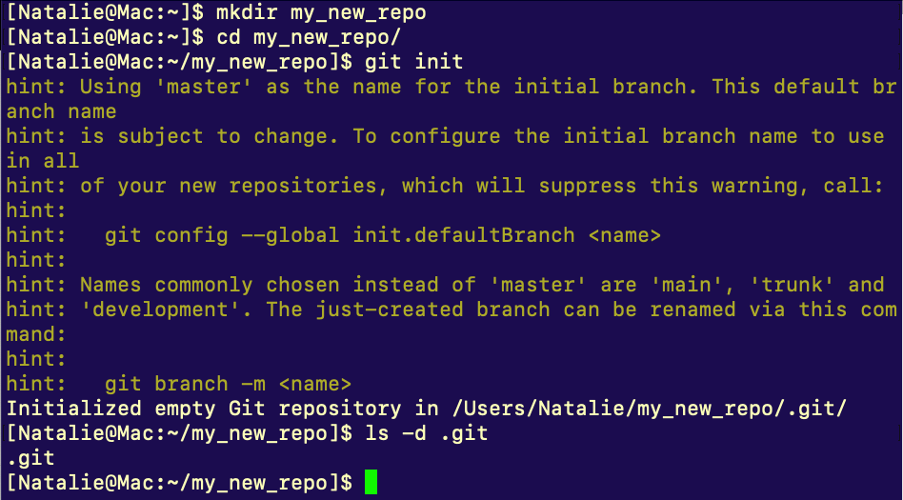
Common Local Git Commands
config: configure your git experience
init: create a new local repository in the existing directory tracked by git
add: add files to be tracked by git
commit: save changes made to the repo
branch: verify a current branch, copy the current branch to create a new one
checkout: check out a specific branch
log: show recorded (committed) change history
status: show changes to repository since the recent commit
diff: show local file/line-by-line changes to the repository since the recent commit
EARTH PREDICTION INNOVATION CENTER (EPIC)

Slide 9
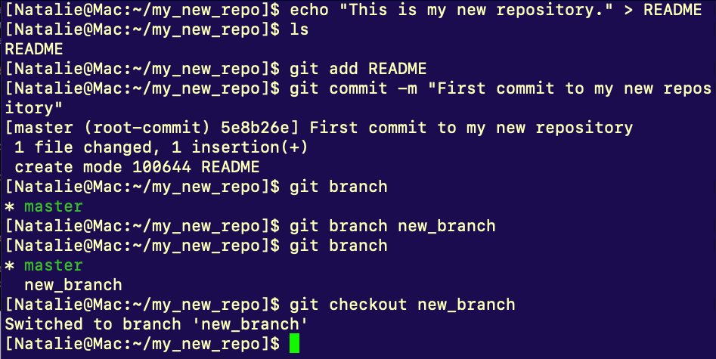
Common Local Git Commands
config: configure your git experience
init: create a new local repository in the existing directory tracked by git
add: add files to be tracked by git
commit: save changes made to the repo
branch: verify a current branch, copy the current branch to create a new one
checkout: check out a specific branch
log: show recorded (committed) change history
status: show changes to repository since the recent commit
diff: show local file/line-by-line changes to the repository since the recent commit
EARTH PREDICTION INNOVATION CENTER (EPIC)

Slide 10
Common Local Git Commands
config: configure your git experience
init: create a new local repository in the existing directory tracked by git
add: add files to be tracked by git
commit: save changes made to the repo
branch: verify a current branch, copy the current branch to create a new one
checkout: check out a specific branch
log: show recorded (committed) change history
status: show changes to repository since the recent commit
diff: show local file/line-by-line changes to the repository since the recent commit
EARTH PREDICTION INNOVATION CENTER (EPIC)

Slide 11
Common Local Git Commands
config: configure your git experience
init: create a new local repository in the existing directory tracked by git
add: add files to be tracked by git
commit: save changes made to the repo
branch: verify a current branch, copy the current branch to create a new one
checkout: check out a specific branch
log: show recorded (committed) change history
status: show changes to repository since the recent commit
diff: show local file/line-by-line changes to the repository since the recent commit
EARTH PREDICTION INNOVATION CENTER (EPIC)

Slide 12
Common Local Git Commands
config: configure your git experience
init: create a new local repository in the existing directory tracked by git
add: add files to be tracked by git
commit: save changes made to the repo
branch: verify a current branch, copy the current branch to create a new one
checkout: check out a specific branch
log: show recorded (committed) change history
status: show changes to repository since the recent commit
diff: show local file/line-by-line changes to the repository since the recent commit
EARTH PREDICTION INNOVATION CENTER (EPIC)

Slide 13
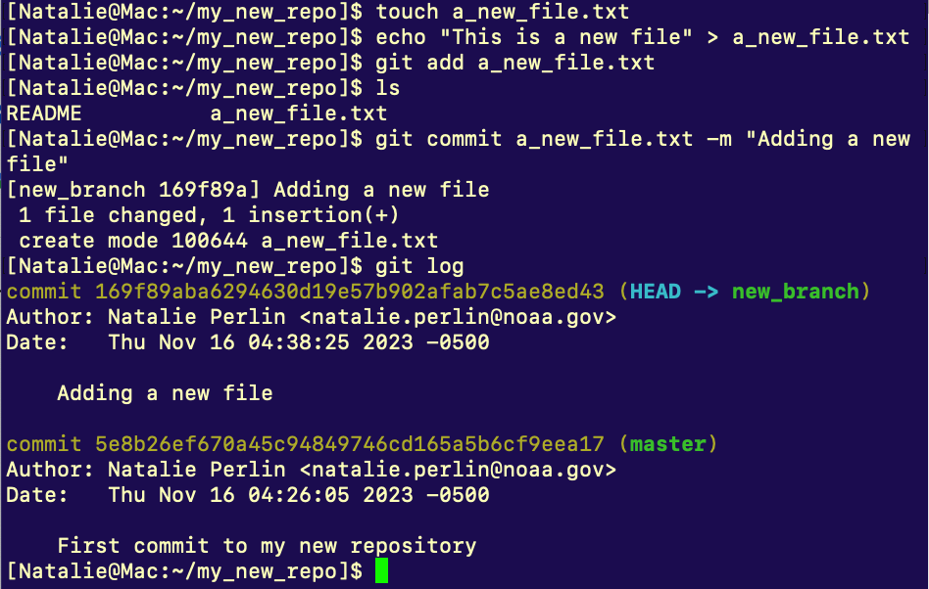
Common Local Git Commands
config: configure your git experience
init: create a new local repository in the existing directory tracked by git
add: add files to be tracked by git
commit: save changes made to the repo
branch: verify a current branch, copy the current branch to create a new one
checkout: check out a specific branch
log: show recorded (committed) change history
status: show changes to repository since the recent commit
diff: show local file/line-by-line changes to the repository since the recent commit
EARTH PREDICTION INNOVATION CENTER (EPIC)

Slide 14
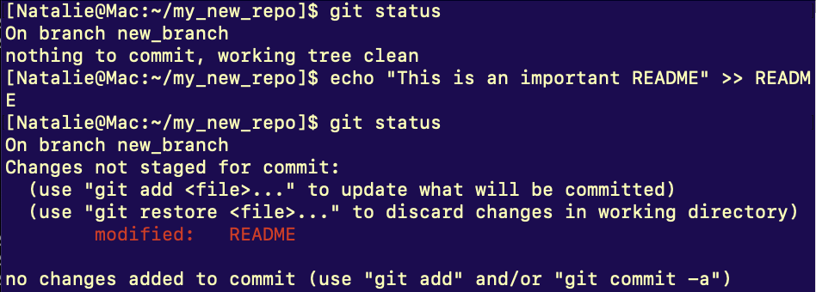
Common Local Git Commands
config: configure your git experience
init: create a new local repository in the existing directory tracked by git
add: add files to be tracked by git
commit: save changes made to the repo
branch: verify a current branch, copy the current branch to create a new one
checkout: check out a specific branch
log: show recorded (committed) change history
status: show changes to repository since the recent commit
diff: show local file/line-by-line changes to the repository since the recent commit
EARTH PREDICTION INNOVATION CENTER (EPIC)

Slide 15
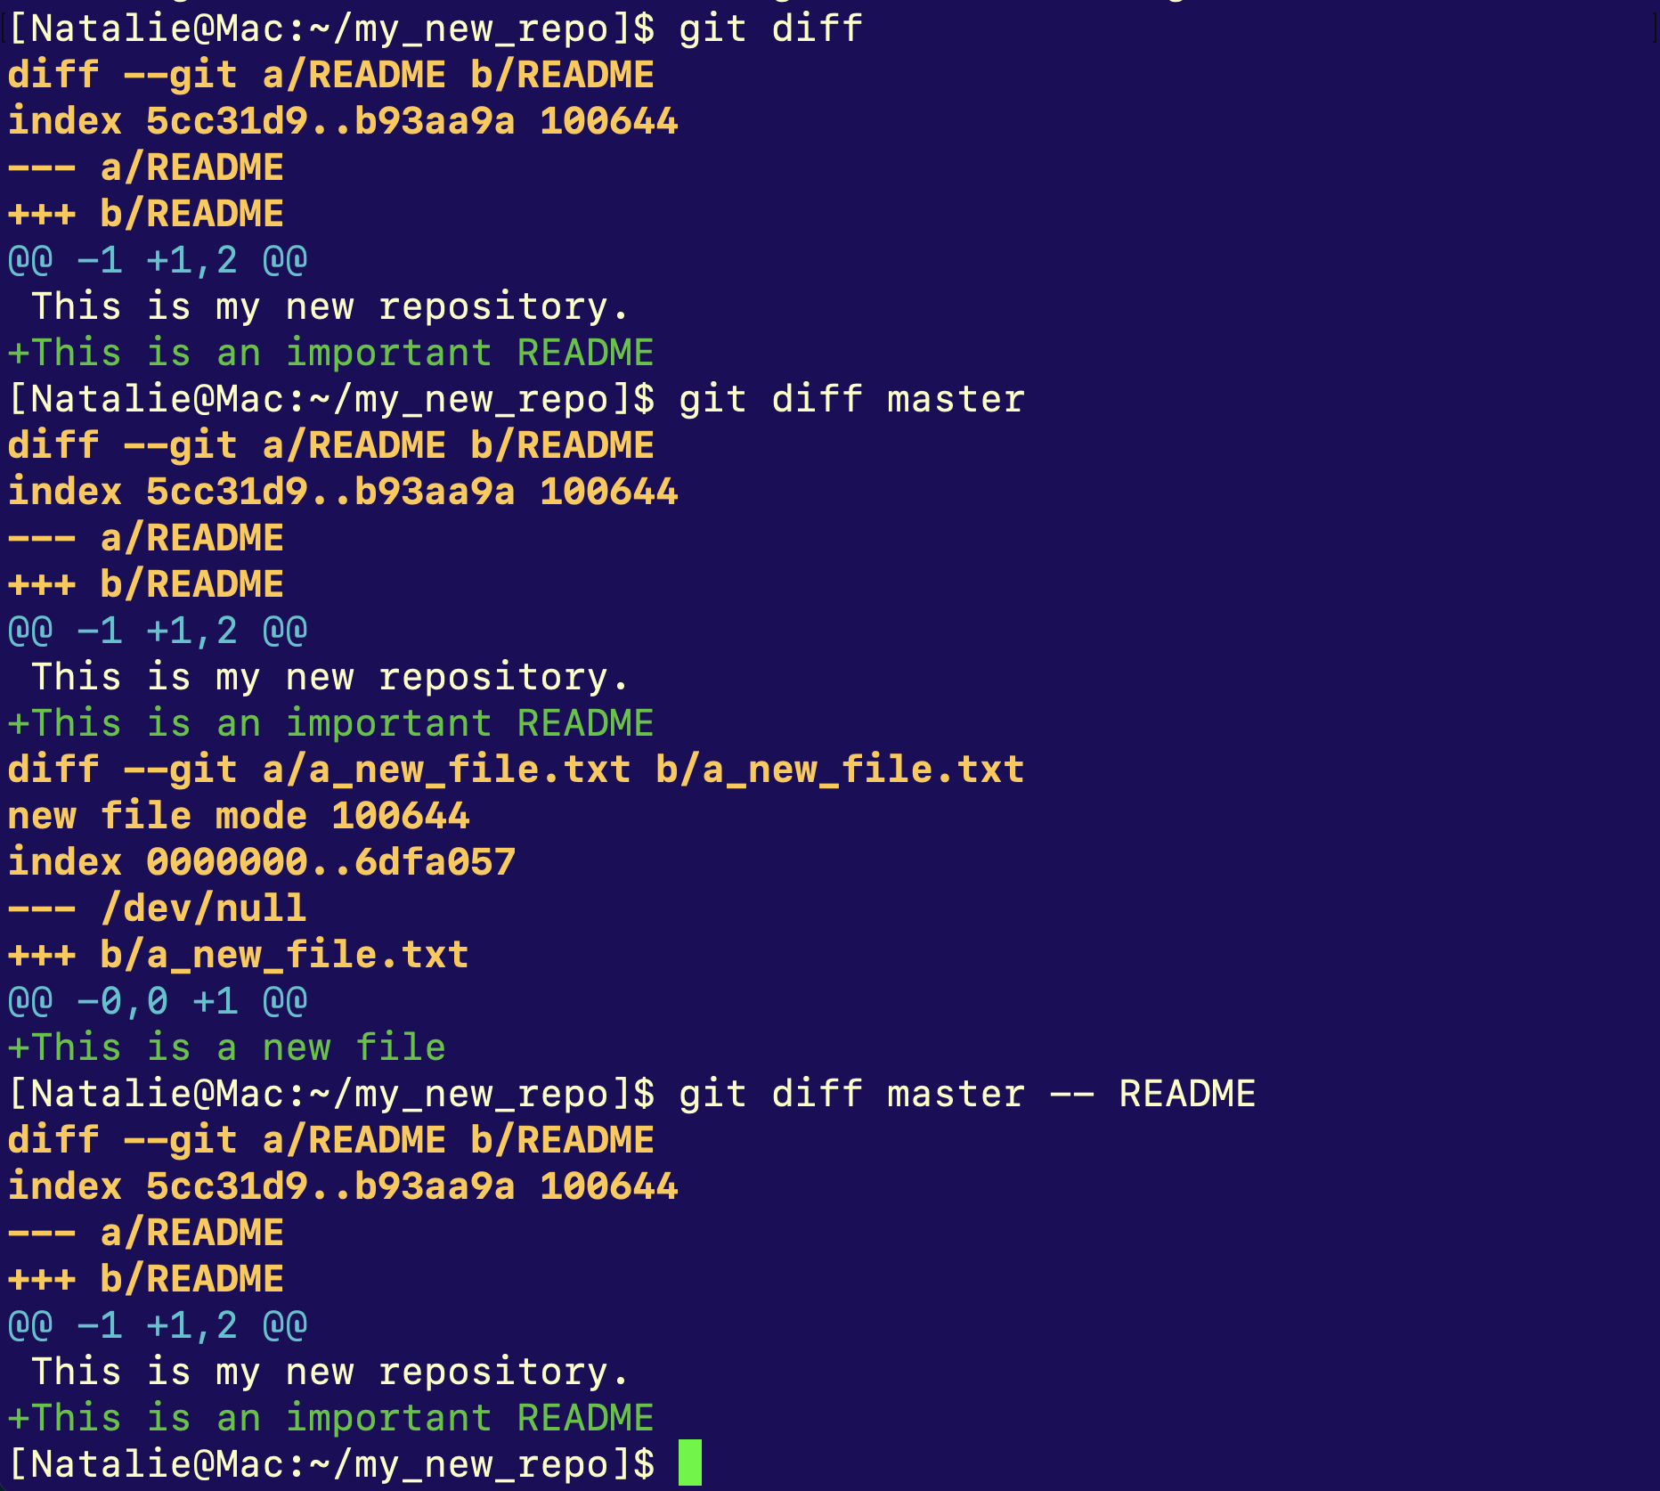
Common Local Git Commands
config: configure your git experience
init: create a new local repository in the existing directory tracked by git
add: add files to be tracked by git
commit: save changes made to the repo
branch: verify a current branch, copy the current branch to create a new one
checkout: check out a specific branch
log: show recorded (committed) change history
status: show changes to repository since the recent commit
diff: show local file/line-by-line changes to the repository since the recent commit
EARTH PREDICTION INNOVATION CENTER (EPIC)

Slide 16
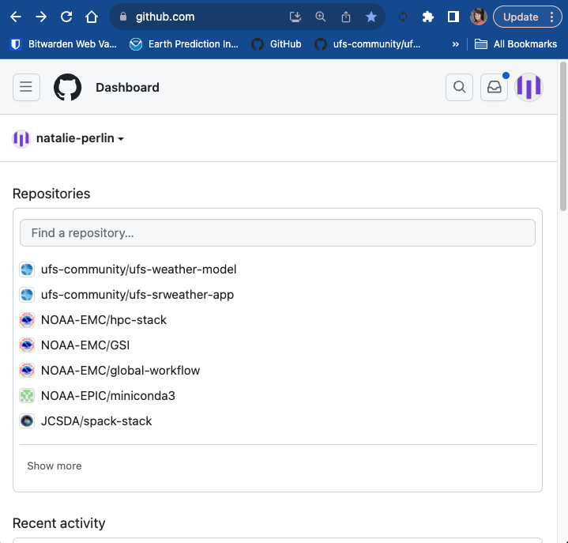
Creating a public GitHub profile
Navigate to https://github.com dashboard
click on your user picture
Choose Settings from the dropdown menu
Fill out your public profile
EARTH PREDICTION INNOVATION CENTER (EPIC)

Slide 17
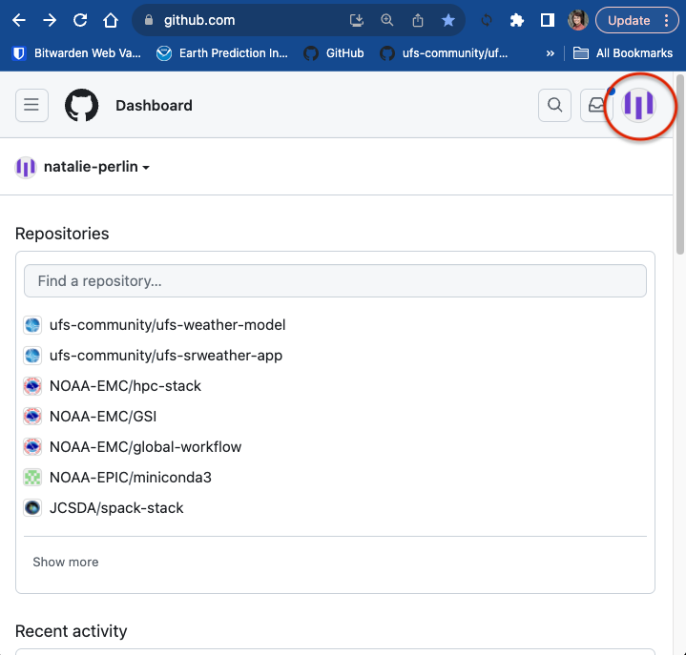
Creating a public GitHub profile
Navigate to https://github.com dashboard
click on your user picture
Choose Settings from the dropdown menu
Fill out your public profile
EARTH PREDICTION INNOVATION CENTER (EPIC)

Slide 18
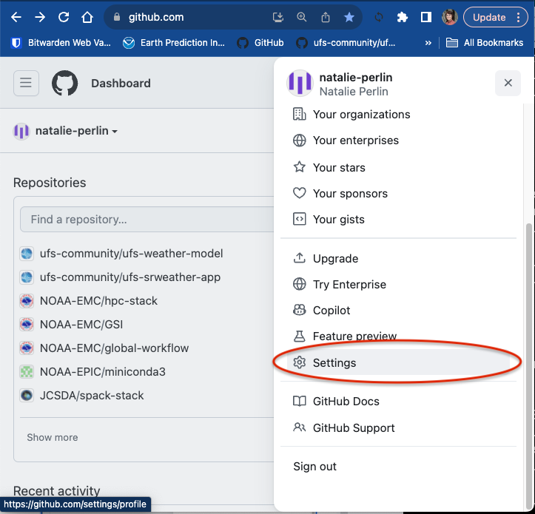
Creating a public GitHub profile
Navigate to https://github.com dashboard
click on your user picture
Choose Settings from the dropdown menu
Fill out your public profile
EARTH PREDICTION INNOVATION CENTER (EPIC)

Slide 19
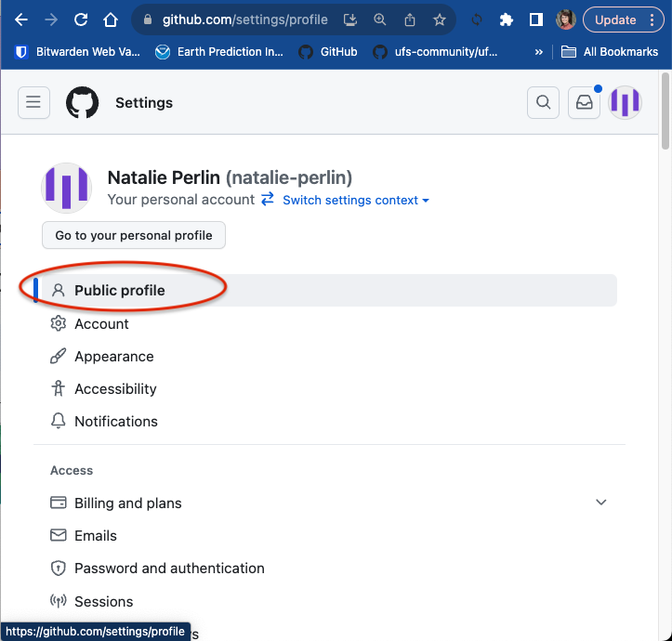
Creating a public GitHub profile
Navigate to https://github.com dashboard
click on your user picture
Choose Settings from the dropdown menu
Fill out your public profile
EARTH PREDICTION INNOVATION CENTER (EPIC)

Slide 20
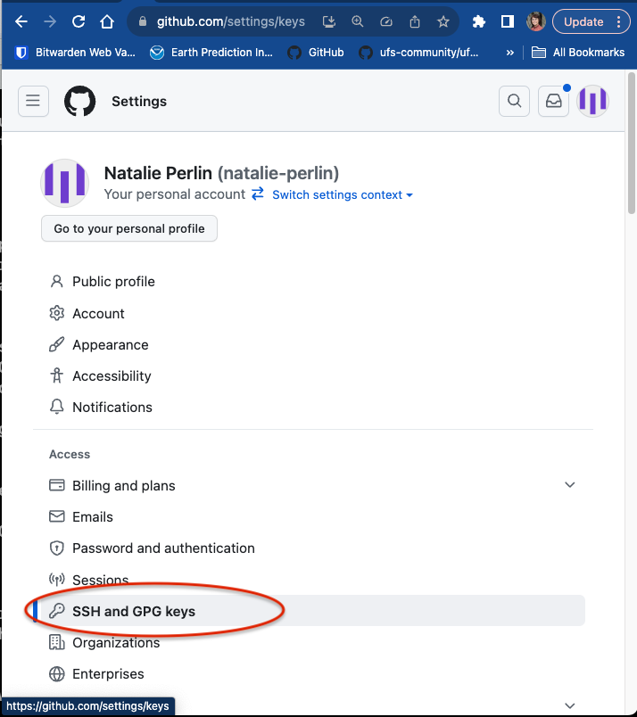
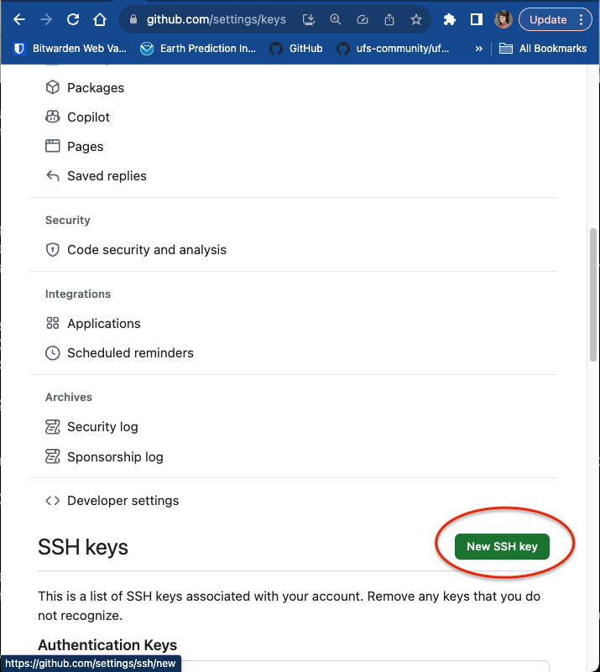
Generate SSH key pair for easy Git/GitHub communication
From Settings, on the left, click on “SSH and GPG keys”, then “New SSH key”
In a local terminal, go to ~/.ssh and generate a key pair:
ssh-keygen -t rsa -b 4096
Name your key (full path) or use a default id_rsa name
Copy the public key from the output:
cat id_rsa.pub
Paste the output into the “Key” portion of the GitHub page
Give it a title and click “Add SSH key”
more help: https://docs.github.com/en/authentication/connecting-to-github-with-ssh/generating-a-new-ssh-key-and-adding-it-to-the-ssh-agent
EARTH PREDICTION INNOVATION CENTER (EPIC)

Slide 21
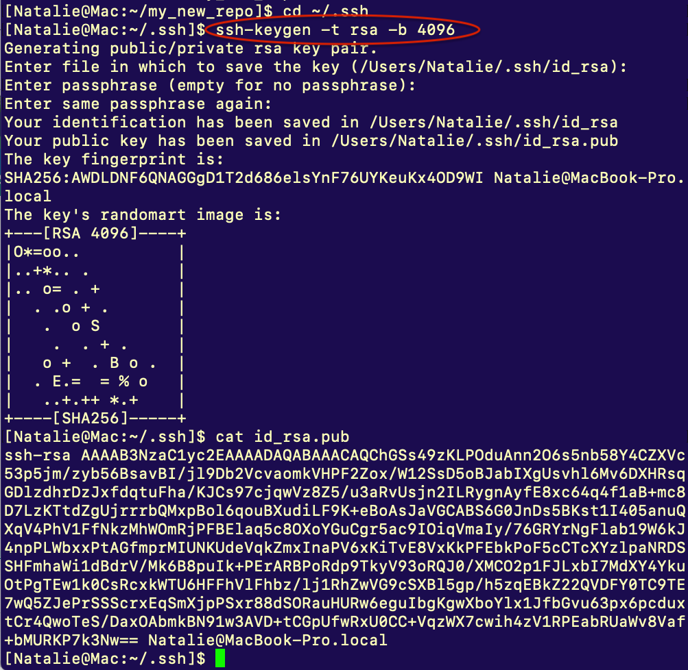
Generate SSH key pair for easy Git/GitHub communication
From Settings, on the left, click on “SSH and GPG keys”, then “New SSH key”
In a local terminal, go to ~/.ssh and generate a key pair:
ssh-keygen -t rsa -b 4096
Name your key (full path) or use a default id_rsa name
Copy the public key from the output:
cat id_rsa.pub
Paste the output into the “Key” portion of the GitHub page
Give it a title and click “Add SSH key”
more help: https://docs.github.com/en/authentication/connecting-to-github-with-ssh/generating-a-new-ssh-key-and-adding-it-to-the-ssh-agent
EARTH PREDICTION INNOVATION CENTER (EPIC)

Slide 22
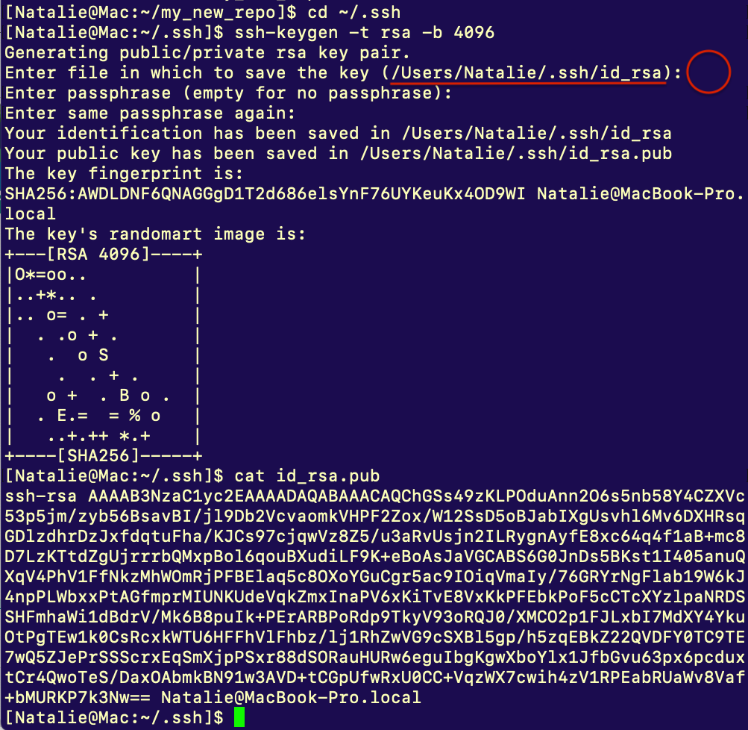
Generate SSH key pair for easy Git/GitHub communication
From Settings, on the left, click on “SSH and GPG keys”, then “New SSH key”
In a local terminal, go to ~/.ssh and generate a key pair:
ssh-keygen -t rsa -b 4096
Name your key (full path) or use a default id_rsa name
Copy the public key from the output:
cat id_rsa.pub
Paste the output into the “Key” portion of the GitHub page
Give it a title and click “Add SSH key”
more help: https://docs.github.com/en/authentication/connecting-to-github-with-ssh/generating-a-new-ssh-key-and-adding-it-to-the-ssh-agent
EARTH PREDICTION INNOVATION CENTER (EPIC)

Slide 23
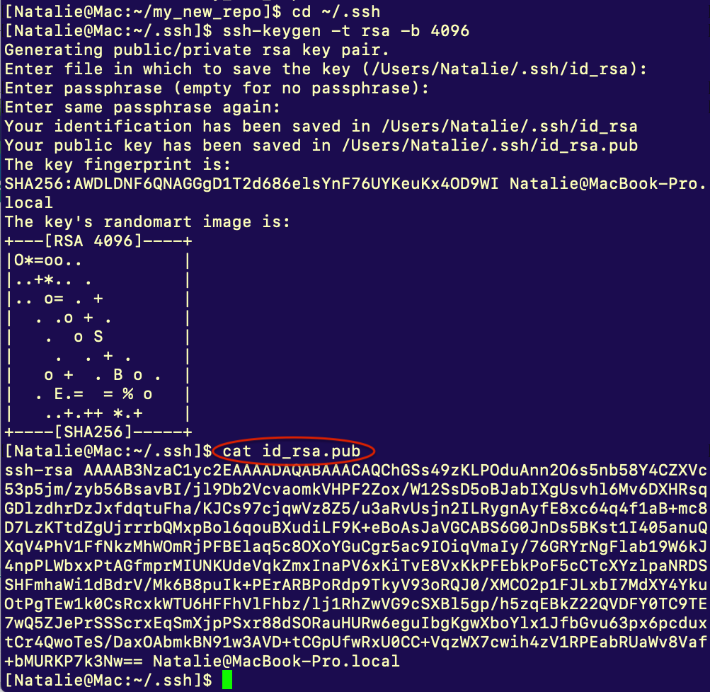
Generate SSH key pair for easy Git/GitHub communication
From Settings, on the left, click on “SSH and GPG keys”, then “New SSH key”
In a local terminal, go to ~/.ssh and generate a key pair:
ssh-keygen -t rsa -b 4096
Name your key (full path) or use a default id_rsa name
Copy the public key from the output:
cat id_rsa.pub
Paste the output into the “Key” portion of the GitHub page
Give it a title and click “Add SSH key”
more help: https://docs.github.com/en/authentication/connecting-to-github-with-ssh/generating-a-new-ssh-key-and-adding-it-to-the-ssh-agent
EARTH PREDICTION INNOVATION CENTER (EPIC)

Slide 24
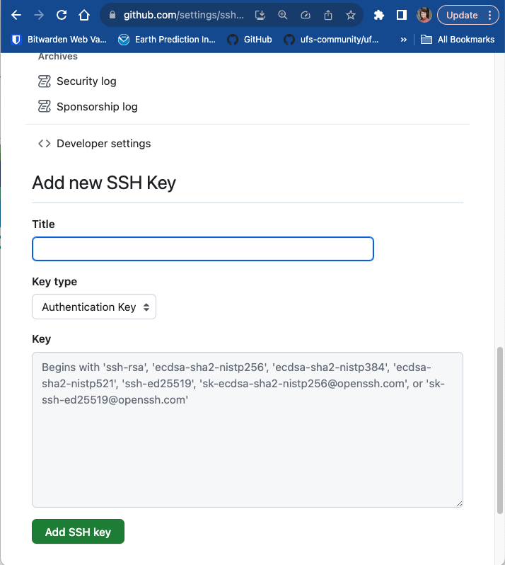
Generate SSH key pair for easy Git/GitHub communication
From Settings, on the left, click on “SSH and GPG keys”, then “New SSH key”
In a local terminal, go to ~/.ssh and generate a key pair:
ssh-keygen -t rsa -b 4096
Name your key (full path) or use a default id_rsa name
Copy the public key from the output:
cat id_rsa.pub
Paste the output into the “Key” portion of the GitHub page
Give it a title and click “Add SSH key”
more help: https://docs.github.com/en/authentication/connecting-to-github-with-ssh/generating-a-new-ssh-key-and-adding-it-to-the-ssh-agent
EARTH PREDICTION INNOVATION CENTER (EPIC)

Slide 25
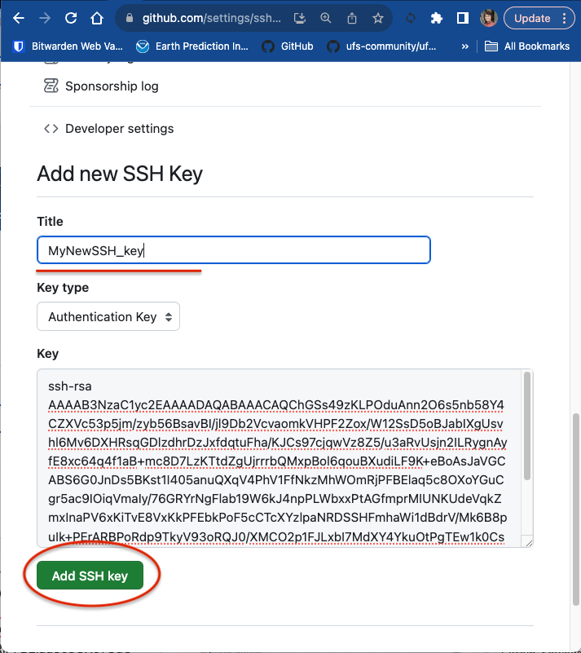
Generate SSH key pair for easy Git/GitHub communication
From Settings, on the left, click on “SSH and GPG keys”, then “New SSH key”
In a local terminal, go to ~/.ssh and generate a key pair:
ssh-keygen -t rsa -b 4096
Name your key (full path) or use a default id_rsa name
Copy the public key from the output:
cat id_rsa.pub
Paste the output into the “Key” portion of the GitHub page
Give it a title and click “Add SSH key”
more help: https://docs.github.com/en/authentication/connecting-to-github-with-ssh/generating-a-new-ssh-key-and-adding-it-to-the-ssh-agent
EARTH PREDICTION INNOVATION CENTER (EPIC)

Slide 26
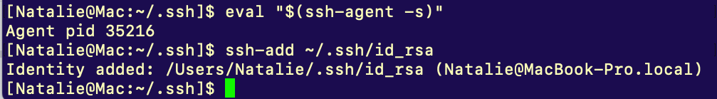
Add a private SSH key to your local ssh agent
Start a new SSH agent:
eval "$(ssh-agent -s)"
Add a new private key to the ssh agent (Mac OS):
ssh-add ~/.ssh/id_rsa
Now pushes (uploads) to your GitHub repositories will not require a password
more help on SSH Keys: https://www.ssh.com/academy/ssh/keygen
https://docs.github.com/en/authentication/connecting-to-github-with-ssh/generating-a-new-ssh-key-and-adding-it-to-the-ssh-agent
EARTH PREDICTION INNOVATION CENTER (EPIC)

Slide 27
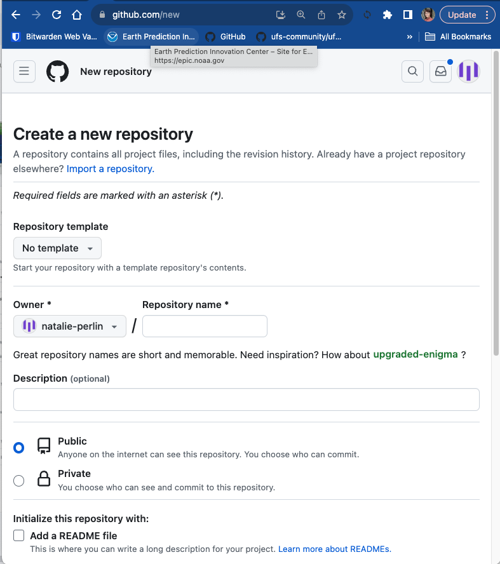
Creating a repository on GitHub
Head to https://github.com/new
Give your new repository a unique name (my_new_repo) and optionally a description
Since we will be pushing (uploading) our repository from the terminal, do not select “Add a README file”
Scroll down and click “Create repository”
EARTH PREDICTION INNOVATION CENTER (EPIC)

Slide 28
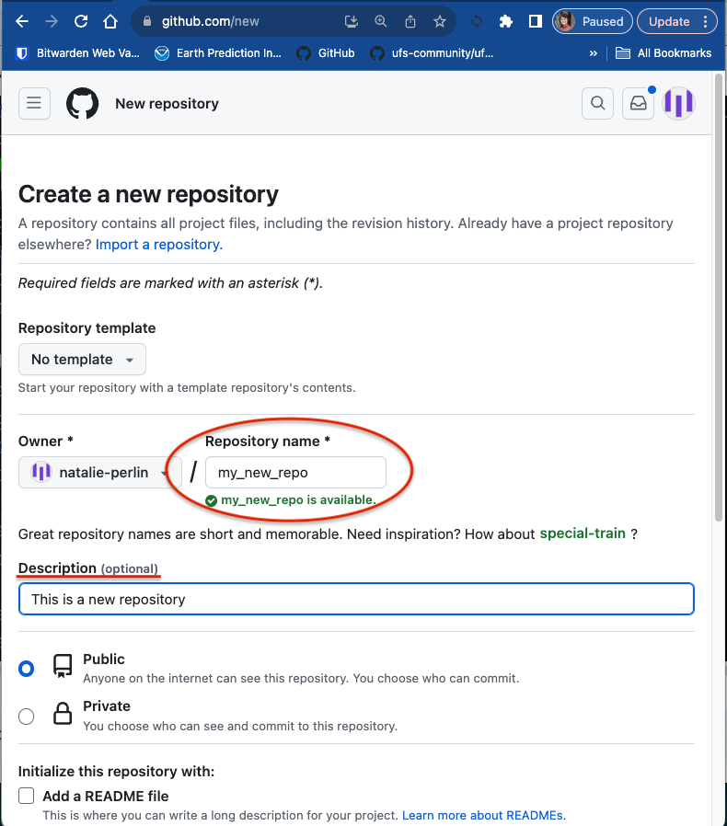
Creating a repository on GitHub
Head to https://github.com/new
Give your new repository a unique name (my_new_repo) and optionally a description
Since we will be pushing (uploading) our repository from the terminal, do not select “Add a README file”
Scroll down and click “Create repository”
EARTH PREDICTION INNOVATION CENTER (EPIC)

Slide 29
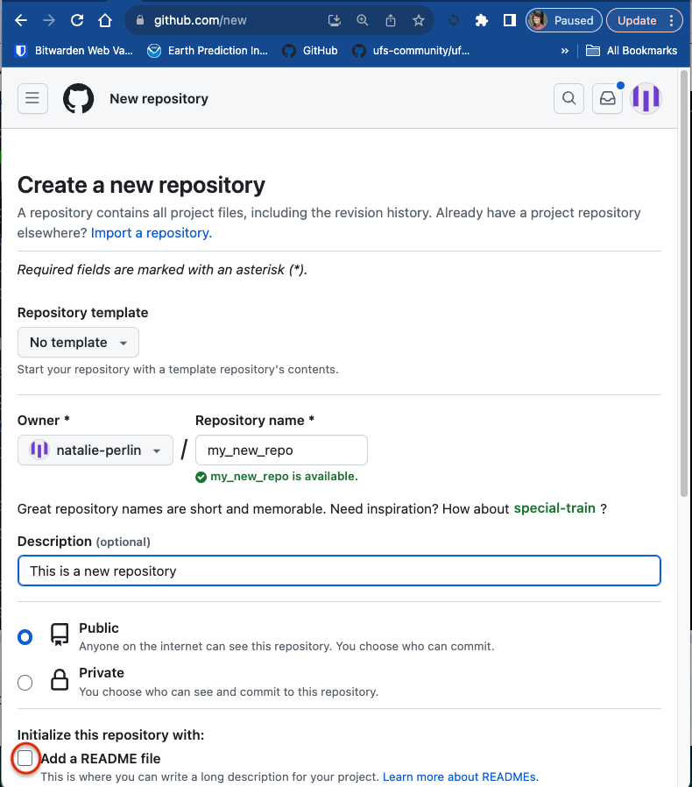
Creating a repository on GitHub
Head to https://github.com/new
Give your new repository a unique name (my_new_repo) and optionally a description
Since we will be pushing (uploading) our repository from the terminal, do not select “Add a README file”
Scroll down and click “Create repository”
EARTH PREDICTION INNOVATION CENTER (EPIC)

Slide 30
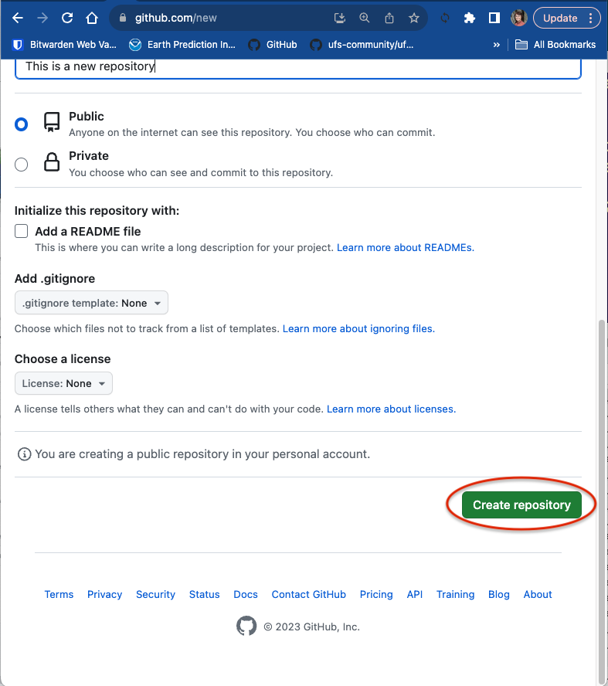
Creating a repository on GitHub
Head to https://github.com/new
Give your new repository a unique name (my_new_repo) and optionally a description
Since we will be pushing (uploading) our repository from the terminal, do not select “Add a README file”
Scroll down and click “Create repository”
EARTH PREDICTION INNOVATION CENTER (EPIC)

Slide 31
Pushing a Repository to GitHub
New gits commands:
push: upload local repository content with committed changes to a remote repository
remote: manage a list of remote entries tracked by a local repository
remote -v : query a remote repository or repositories tracked
remote add origin: "origin" remote refers to the default remote repository name
EARTH PREDICTION INNOVATION CENTER (EPIC)

Slide 32
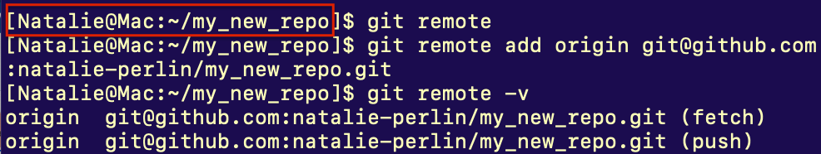
Pushing a Repository to GitHub
Return to your terminal and navigate back to your new repository (my_new_repo)
Set the remote URL for the repository using git remote add origin
Push both branches to GitHub
Congrats on your new repo!! Go check it out on GitHub!
EARTH PREDICTION INNOVATION CENTER (EPIC)

Slide 33
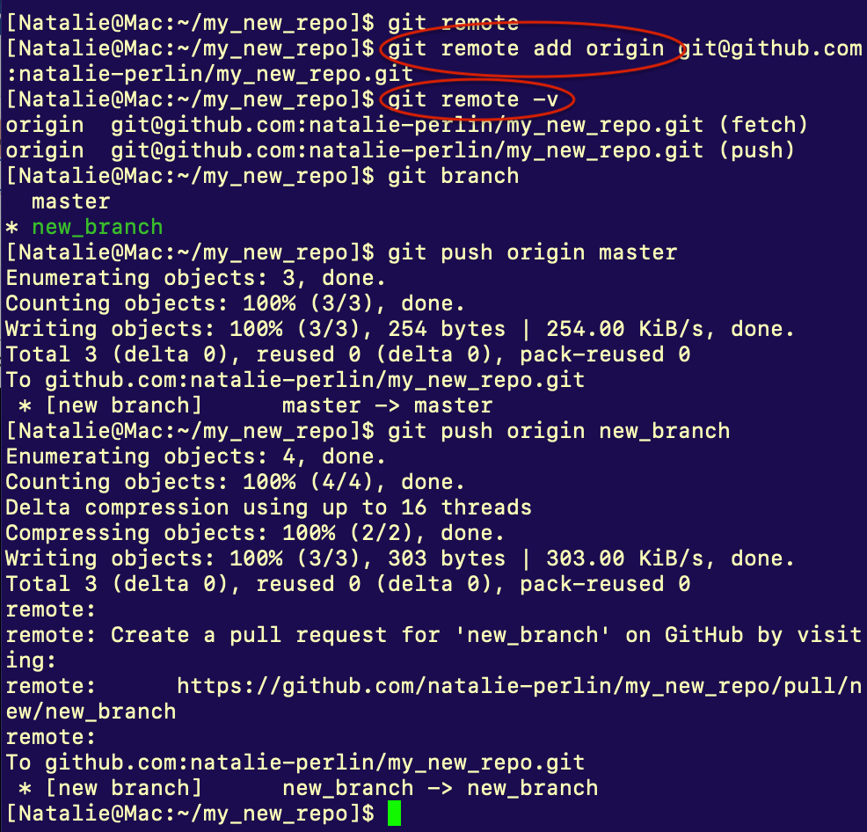
Pushing a Repository to GitHub
Return to your terminal and navigate back to your new repository (my_new_repo)
Set the remote URL for the repository using git remote add origin
Push both branches to GitHub
Congrats on your new repo!! Go check it out on GitHub!
EARTH PREDICTION INNOVATION CENTER (EPIC)

Slide 34
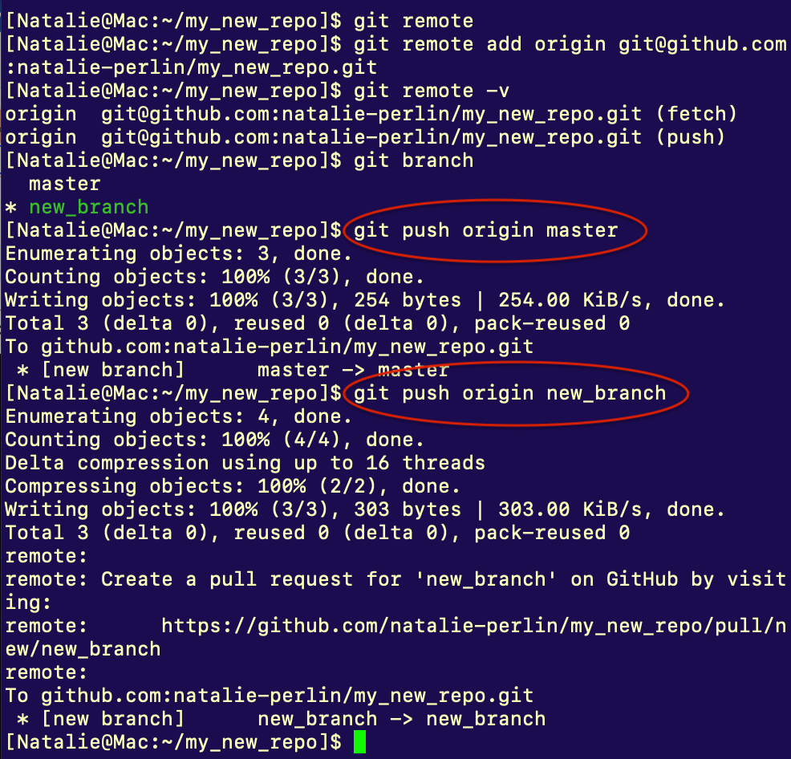
Pushing a Repository to GitHub
Return to your terminal and navigate back to your new repository (my_new_repo)
Set the remote URL for the repository using git remote add origin
Push both branches to GitHub
Congrats on your new repo!! Go check it out on GitHub!
EARTH PREDICTION INNOVATION CENTER (EPIC)

Slide 35
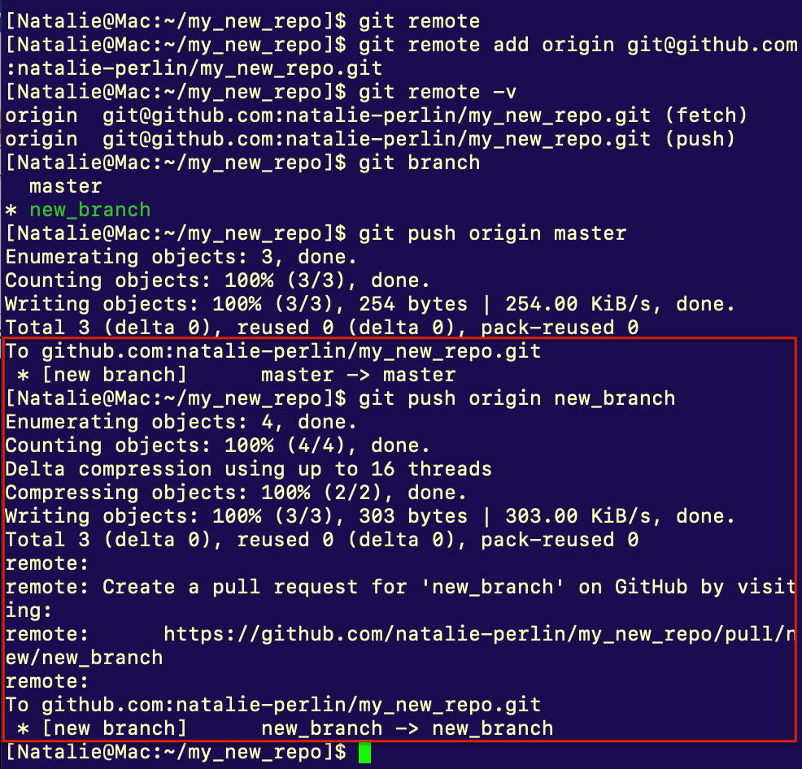
Pushing a Repository to GitHub
Return to your terminal and navigate back to your new repository (my_new_repo)
Set the remote URL for the repository using git remote add origin
Push both branches to GitHub
Congrats on your new repo!! Go check it out on GitHub!
EARTH PREDICTION INNOVATION CENTER (EPIC)

Slide 36
Part 2. Working with Remote Repositories
Checkout remote repositories: forks and clones
Creating and managing GitHub forks, branches
Submitting pull requests
Fetching and merging remote branches
Resolve merge conflicts
Keeping local repositories in sync with remote ones
EARTH PREDICTION INNOVATION CENTER (EPIC)

Slide 37
Navigating GitHub Repositories
Any public Git repository can be forked or cloned.
fork: a completely independent copy of Git repository
clone: a linked copy synchronized with the target/remote repo
Navigate to https://github.com/NOAA-EPIC/training-github
(or https://github.com/ufs-community/ufs-srweather-app )
Look through the Issues and Pull requests
Hop onto the Discussions and reply to a thread
Create your own fork of the repository
Navigate to the main repository page by clicking on “Code”
In the top-right corner, click on “Fork”
Keep the “Repository name” and “Description” fields unchanged
Click “Create fork”
EARTH PREDICTION INNOVATION CENTER (EPIC)

Slide 38
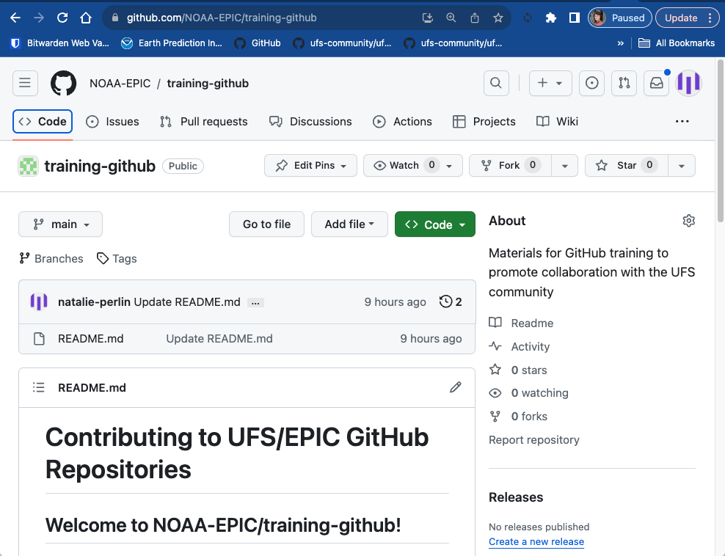
Navigating GitHub Repositories
Any public Git repository can be forked or cloned.
fork: a completely independent copy of Git repository
clone: a linked copy synchronized with the target/remote repo
Navigate to https://github.com/NOAA-EPIC/training-github
(or https://github.com/ufs-community/ufs-srweather-app )
Look through the Issues and Pull requests
Hop onto the Discussions and reply to a thread
Create your own fork of the repository
Navigate to the main repository page by clicking on “Code”
In the top-right corner, click on “Fork”
Keep the “Repository name” and “Description” fields unchanged
Click “Create fork”
EARTH PREDICTION INNOVATION CENTER (EPIC)

Slide 39
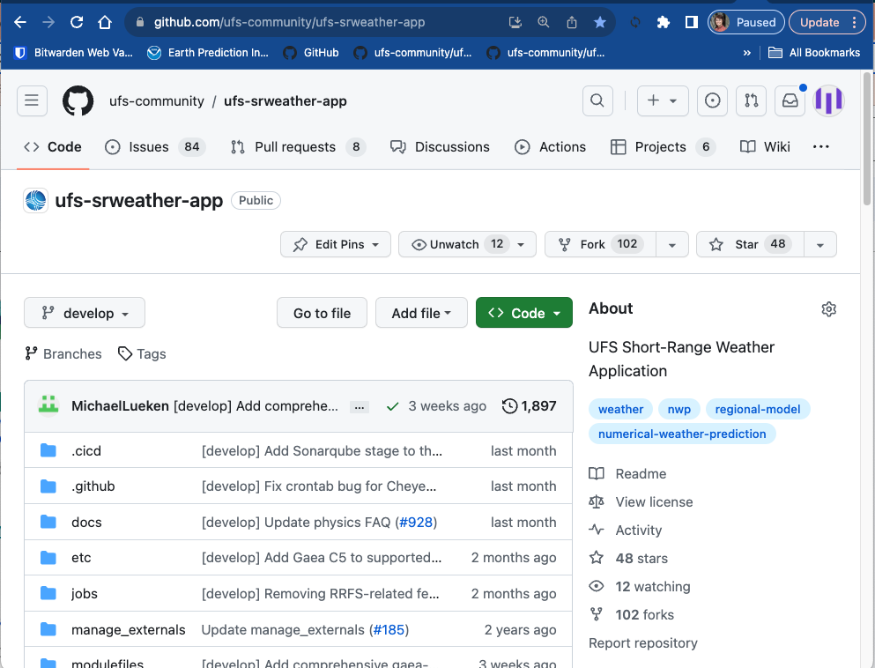
Navigate a GitHub Repository - Create a Fork
Any public Git repository can be forked or cloned.
fork: a completely independent copy of Git repository
clone: a linked copy synchronized with the target/remote repo
Navigate to https://github.com/NOAA-EPIC/training-github
(or https://github.com/ufs-community/ufs-srweather-app )
Look through the Issues and Pull requests
Hop onto the Discussions and reply to a thread
Create your own fork of the repository
Navigate to the main repository page by clicking on “Code”
In the top-right corner, click on “Fork”
Keep the “Repository name” and “Description” fields unchanged
Click “Create fork”
EARTH PREDICTION INNOVATION CENTER (EPIC)

Slide 40
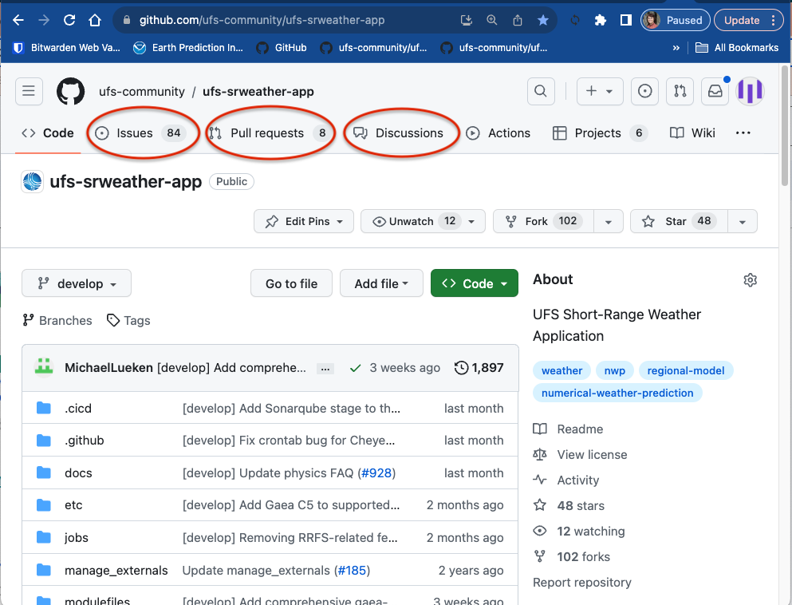
Navigate a GitHub Repository - Create a Fork
Any public Git repository can be forked or cloned.
fork: a completely independent copy of Git repository
clone: a linked copy synchronized with the target/remote repo
Navigate to https://github.com/NOAA-EPIC/training-github
(or https://github.com/ufs-community/ufs-srweather-app )
Look through the Issues and Pull requests
Hop onto the Discussions and reply to a thread
Create your own fork of the repository
Navigate to the main repository page by clicking on “Code”
In the top-right corner, click on “Fork”
Keep the “Repository name” and “Description” fields unchanged
Click “Create fork”
EARTH PREDICTION INNOVATION CENTER (EPIC)

Slide 41
Navigating GitHub Repositories
Navigate a GitHub Repository - Create a Fork
Any public Git repository can be forked or cloned.
fork: a completely independent copy of Git repository
clone: a linked copy that remains synchronized with the target/remote repo
Navigate to https://github.com/NOAA-EPIC/training-github
Look through the Issues and Pull requests
Hop onto the Discussions and reply to a thread
Create your own fork of the repository
Navigate to the main repository page by clicking on “Code”
In the top-right corner, click on “Fork” --> “Create a new fork”
Keep the “Repository name” and “Description” fields unchanged
Click “Create fork”
EARTH PREDICTION INNOVATION CENTER (EPIC)

Slide 42
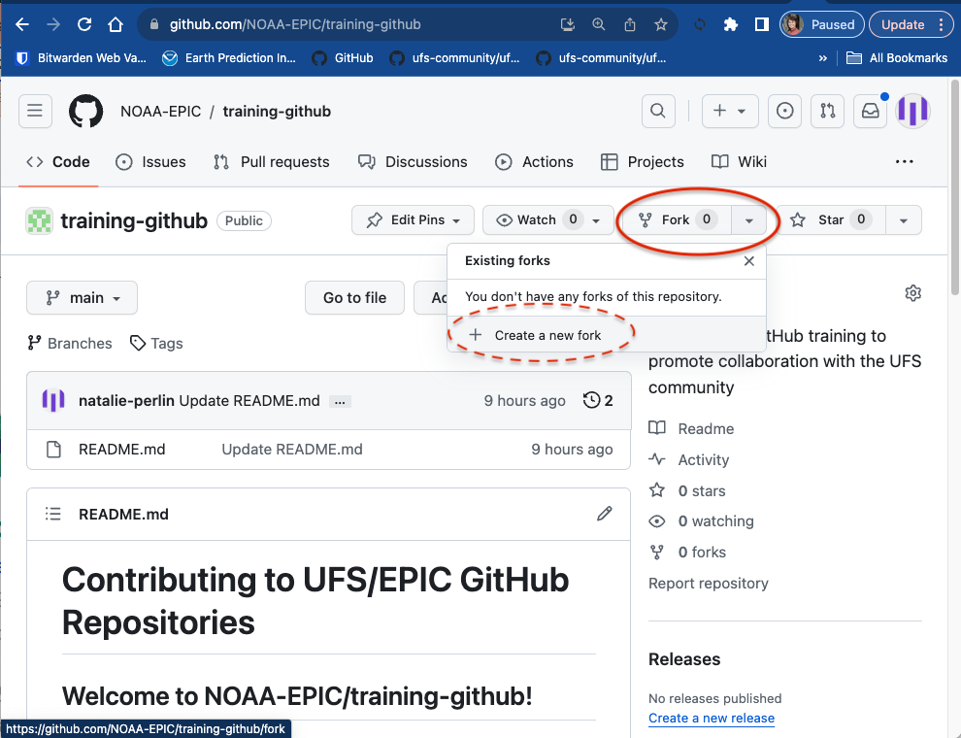
Navigate a GitHub Repository - Create a Fork
Any public Git repository can be forked or cloned.
fork: a completely independent copy of Git repository
clone: a linked copy that remains synchronized with the target/remote repo
Navigate to https://github.com/NOAA-EPIC/training-github
Look through the Issues and Pull requests
Hop onto the Discussions and reply to a thread
Create your own fork of the repository
Navigate to the main repository page by clicking on “Code”
In the top-right corner, click on “Fork” --> “Create a new fork”
Keep the “Repository name” and “Description” fields unchanged
Click “Create fork”
EARTH PREDICTION INNOVATION CENTER (EPIC)

Slide 43
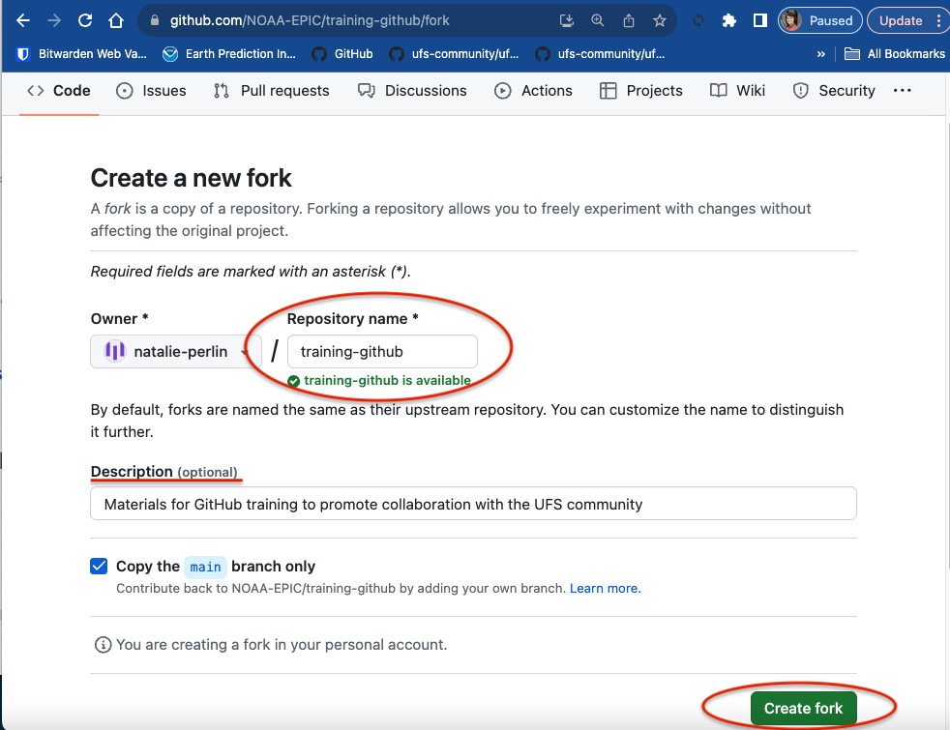
Navigate a GitHub Repository - Create a Fork
Any public Git repository can be forked or cloned.
fork: a completely independent copy of Git repository
clone: a linked copy that remains synchronized with the target/remote repo
Navigate to https://github.com/NOAA-EPIC/training-github
Look through the Issues and Pull requests
Hop onto the Discussions and reply to a thread
Create your own fork of the repository
Navigate to the main repository page by clicking on “Code”
In the top-right corner, click on “Fork” --> “Create a new fork”
Keep the “Repository name” and “Description” fields unchanged
Click “Create fork”
EARTH PREDICTION INNOVATION CENTER (EPIC)

Slide 44
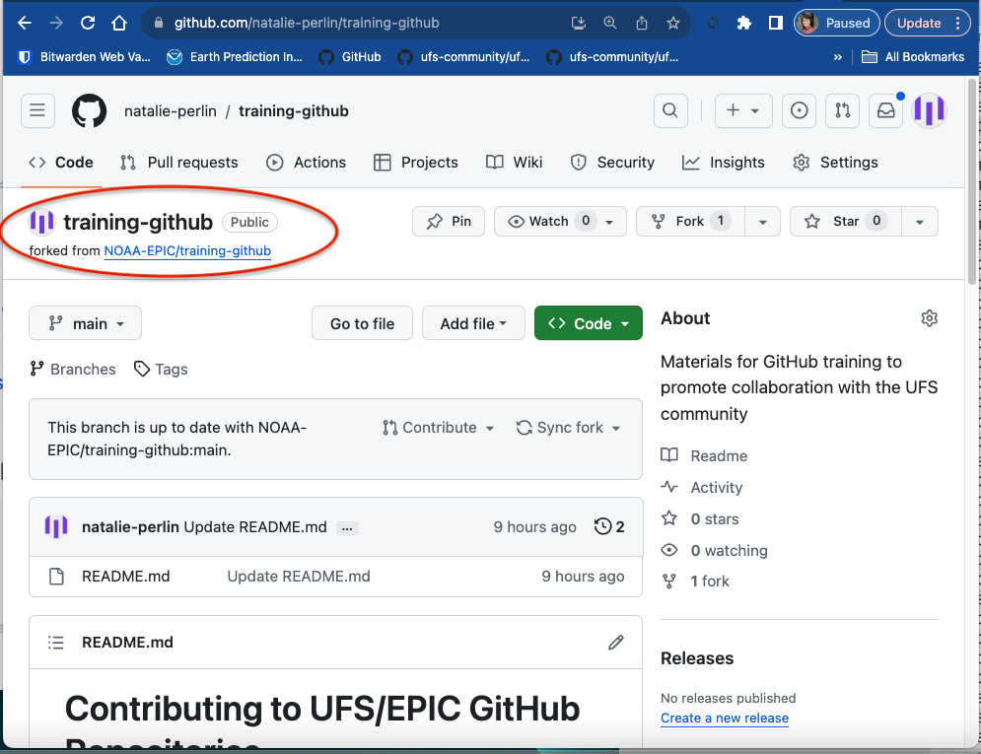
Navigate a GitHub Repository - Create a Fork
Any public Git repository can be forked or cloned.
fork: a completely independent copy of Git repository
clone: a linked copy that remains synchronized with the target/remote repo
Navigate to https://github.com/NOAA-EPIC/training-github
Look through the Issues and Pull requests
Hop onto the Discussions and reply to a thread
Create your own fork of the repository
Navigate to the main repository page by clicking on “Code”
In the top-right corner, click on “Fork” --> “Create a new fork”
Keep the “Repository name” and “Description” fields unchanged
Click “Create fork”
EARTH PREDICTION INNOVATION CENTER (EPIC)

